Slide 1
SQL

Slide 2

Database
Database is collection of data in a format that can be easily accessed (Digital)
A software application used to manage our DB is called DBMS (Database Management System)

Slide 3


Types of Databases
Relational
Data stored in tables
Non-relational (NoSQL)
data not stored in tables
** We use SQL to work with relational DBMS

Slide 4
What is SQL?
Structured Query Language
SQL is a programming language used to interact with relational databases. It is used to perform CRUD operations :
Create
Read Update Delete

Slide 5
Installation of SQL
Follow the Document of SQL Setup

Slide 6
Database Structure
Database (College)
Table 1 (Students
Table 2 ( Teacher)
Data
Data

Slide 7
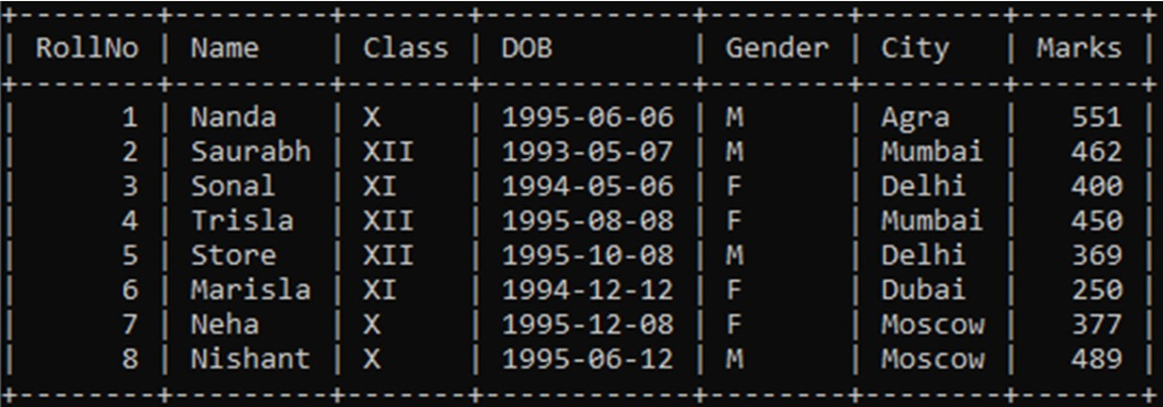
What is a table?
Student table

Slide 8
Creating our First Database
Our first SQL Query
CREATE DATABASE db_name;
DROP DATABASE db_name;

Slide 9
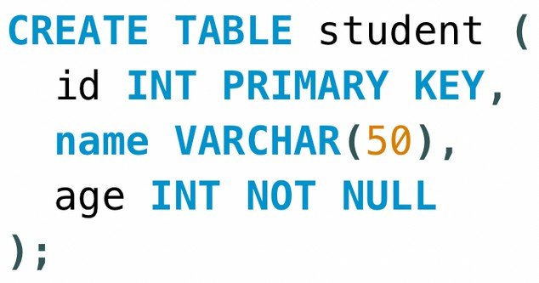
Creating our First Table
USE db_name;
CREATE TABLE table_name ( column_name1 datatype constraint, column_name2 datatype constraint, column_name2 datatype constraint
);

Slide 10
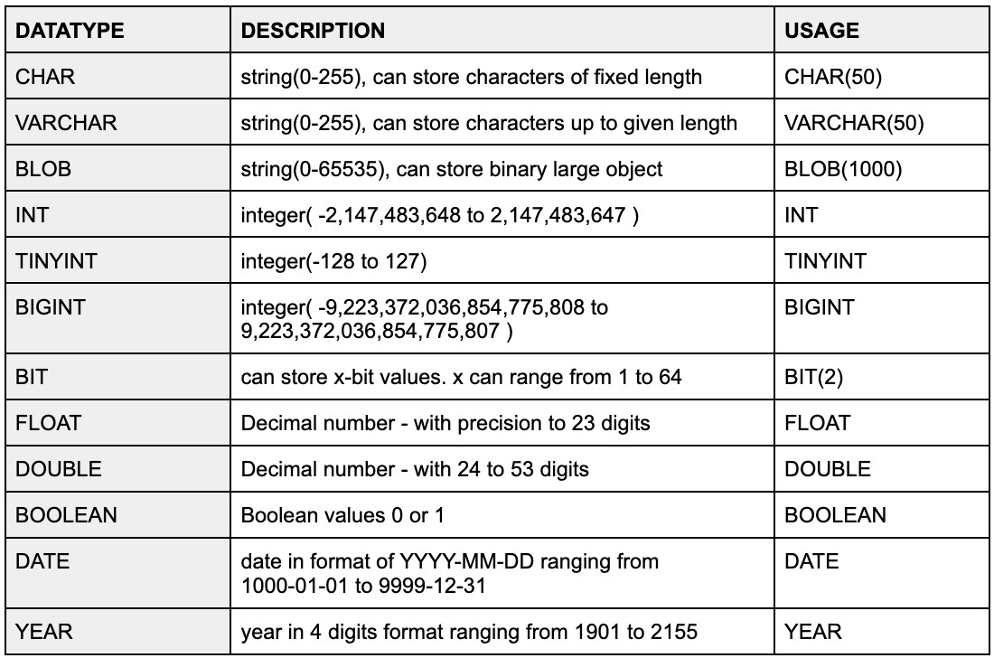
SQL Datatypes
They define the type of values that can be stored in a column

Slide 11
SQL Datatypes
Signed & Unsigned
TINYINT UNSIGNED (0 to 255)
TINYINT (-128 to 127)

Slide 12
Types of SQL Commands
DDL (Data Definition Language) : create, alter, rename, truncate & drop
DQL (Data Query Language) : select
DML (Data Manipulation Language) : select, insert, update & delete
DCL (Data Control Language) : grant & revoke permission to users
TCL (Transaction Control Language) : start transaction, commit, rollback etc.

Slide 13
Database related Queries
CREATE DATABASE db_name;
CREATE DATABASE IF NOT EXISTS db_name;
DROP DATABASE db_name;
DROP DATABASE IF EXISTS db_name;
SHOW DATABASES;
SHOW TABLES;

Slide 14
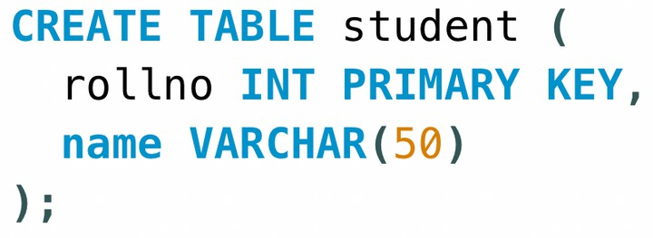
Table related Queries
Create
CREATE TABLE table_name ( column_name1 datatype constraint, column_name2 datatype constraint,
);

Slide 15
Table related Queries
Select & View ALL columns
SELECT * FROM table_name;

Slide 16
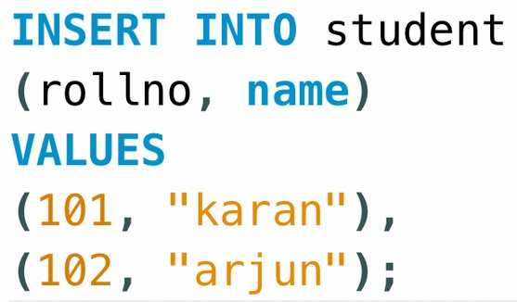
Table related Queries
Insert
INSERT INTO table_name (colname1, colname2); VALUES
(col1_v1, col2_v1), (col1_v2, col2_v2);

Slide 17

Keys
Primary Key
It is a column (or set of columns) in a table that uniquely identifies each row. (a unique id) There is only 1 PK & it should be NOT null.
Foreign Key
A foreign key is a column (or set of columns) in a table that refers to the primary key in another table. There can be multiple FKs.
FKs can have duplicate & null values.

Slide 18
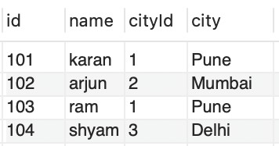
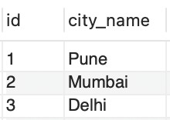
Keys
table1 - Student
table2 - City

Slide 19



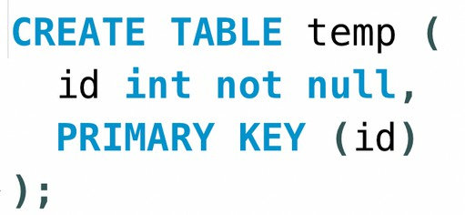
Constraints
SQL constraints are used to specify rules for data in a table.
NOT NULL columns cannot have a null value
UNIQUE
all values in column are different
PRIMARY KEY
makes a column unique & not null but used only for one

Slide 20
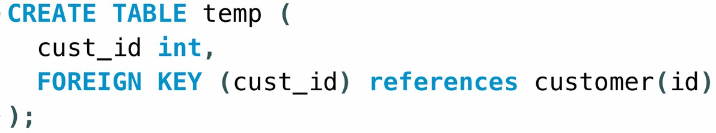
Constraints
FOREIGN KEY prevent actions that would destroy links between tables
DEFAULT
sets the default value of a column

Slide 21
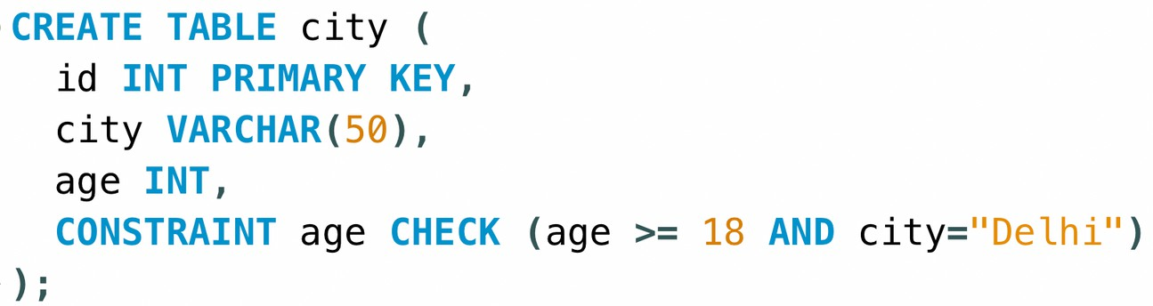
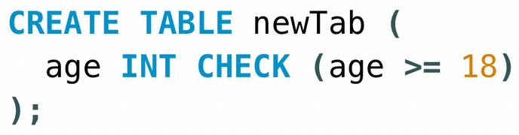
Constraints
CHECK it can limit the values allowed in a column

Slide 22
Insert this data
Create this sample table

Slide 23
Select in Detail
used to select any data from the database
Basic Syntax
SELECT col1, col2 FROM table_name;
To Select ALL
SELECT * FROM table_name;

Slide 24

Where Clause
To define some conditions
SELECT col1, col2 FROM table_name
WHERE conditions;

Slide 25
Where Clause
Using Operators in WHERE
Arithmetic Operators : +(addition) , -(subtraction), *(multiplication), /(division), %(modulus) Comparison Operators : = (equal to), != (not equal to), > , >=, <, <=
Logical Operators : AND, OR , NOT, IN, BETWEEN, ALL, LIKE, ANY
Bitwise Operators : & (Bitwise AND), | (Bitwise OR)

Slide 26
Operators
AND (to check for both conditions to be true)
OR (to check for one of the conditions to be true)

Slide 27
Operators
Between (selects for a given range)
In (matches any value in the list)
NOT (to negate the given condition)

Slide 28
Limit Clause
Sets an upper limit on number of (tuples)rows to be returned
SELECT col1, col2 FROM table_name
LIMIT number;

Slide 29

Order By Clause
To sort in ascending (ASC) or descending order (DESC)
SELECT col1, col2 FROM table_name
ORDER BY col_name(s) ASC;

Slide 30


Aggregate Functions
Aggregare functions perform a calculation on a set of values, and return a single value.
COUNT( ) MAX( )
MIN( )
SUM( )
AVG( )
Get Maximum Marks
Get Average marks

Slide 31
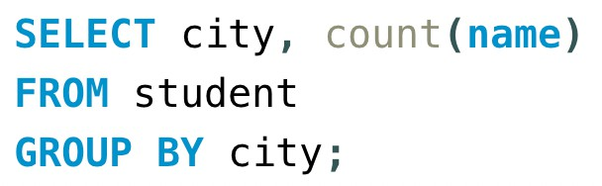
Group By Clause
Groups rows that have the same values into summary rows.
It collects data from multiple records and groups the result by one or more column.
*Generally we use group by with some aggregation function.
Count number of students in each city

Slide 32
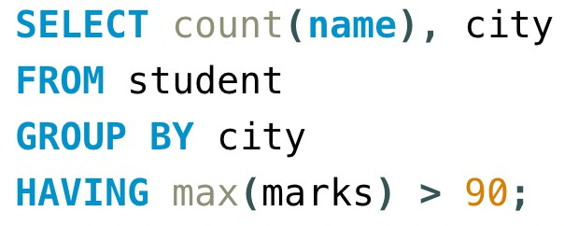
Having Clause
Similar to Where i.e. applies some condition on rows. Used when we want to apply any condition after grouping.
Count number of students in each city where max marks cross 90.

Slide 33
General Order
SELECT column(s) FROM table_name WHERE condition GROUP BY column(s) HAVING condition
ORDER BY column(s) ASC;

Slide 34
Having Clause
Similar to Where i.e. applies some condition on rows. Used when we want to apply any condition after grouping.
Count number of students in each city where max marks cross 90.

Slide 35
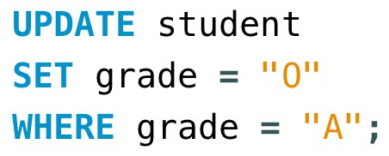
Table related Queries
Update (to update existing rows)
UPDATE table_name
SET col1 = val1, col2 = val2
WHERE condition;

Slide 36

Table related Queries
Delete (to delete existing rows)
DELETE FROM table_name
WHERE condition;

